Slide 1


Soccer Analytics
Exploratory Work & Analysis Questions

Slide 2

Dataset overview
Collection of soccer logs containing events (passes, shots, fouls, etc..)
Events are tagged by position, time, outcome, players involved, and other identifiers specific to the events (e.g.: pass completed/intercepted/off target)
Data collected from Wyscout through human analysts trained to study video footage with the help of a proprietary tagger software
Each touch gets mapped to a new event
Matches, teams, coaches, competitions, and player data is also provided, with individual player traits, game lineups, venue, substitutions
Coverage of the 2017/18 season for five European leagues: Spanish first division, Italian first division, English first division, German first division, French first division.
International coverage for Euro 2016 and World Cup 2018

Slide 3
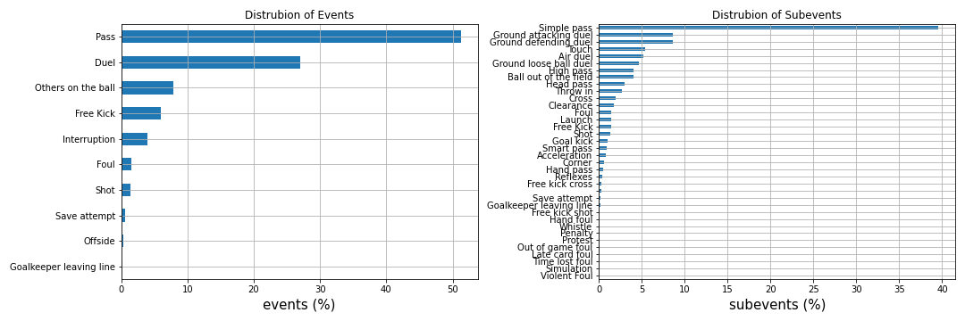
High Level Event Statistics

Slide 4
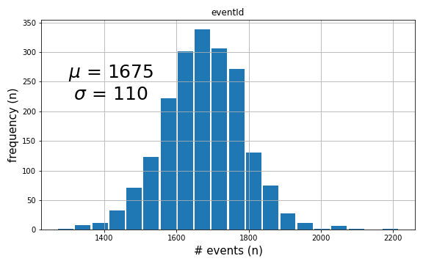
Event distribution per game

Slide 5
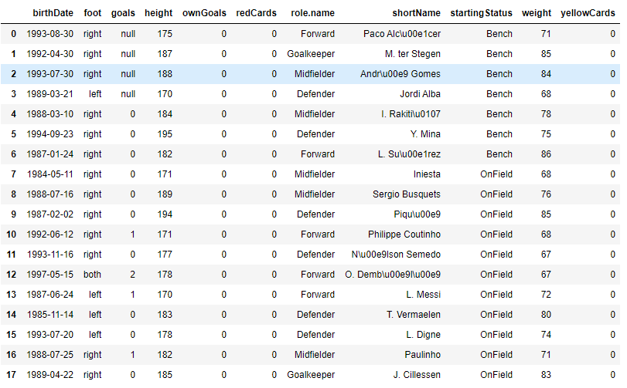
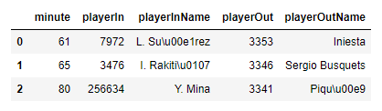
match Lineups
Substitutions

Slide 6


Spatial Analysis

Slide 7
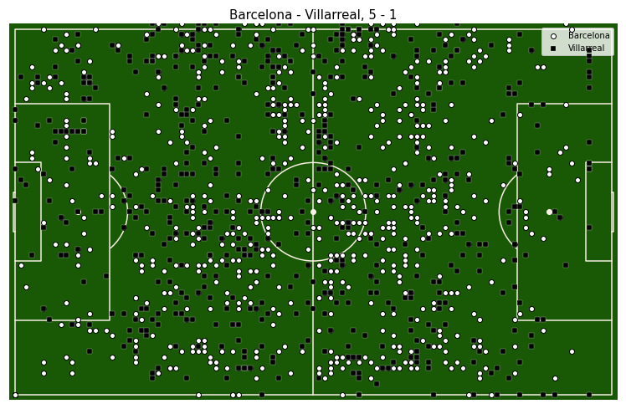
match Heatmap

Slide 8
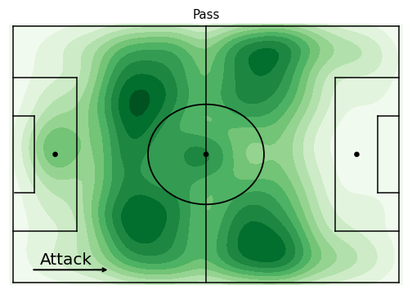
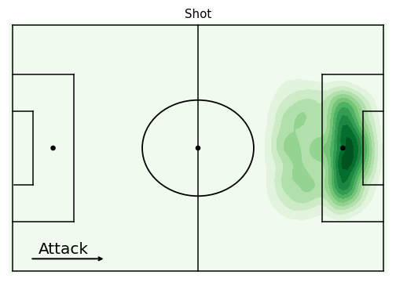
2d Kernel density plots

Slide 9
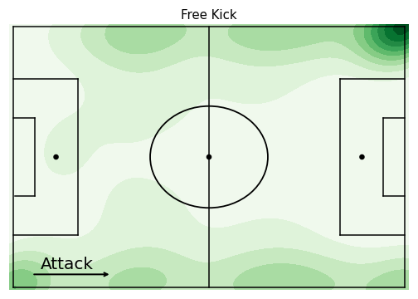
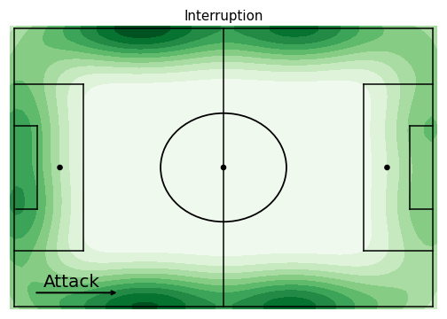
2d Kernel density plots

Slide 10
Temporal Analysis

Slide 11
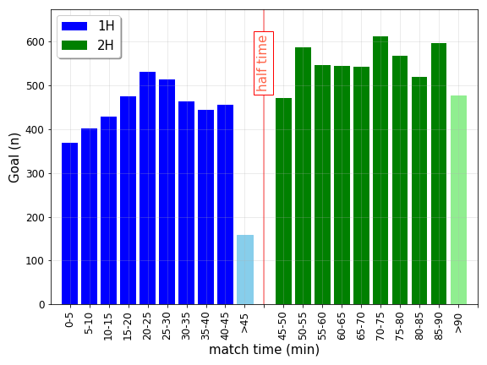
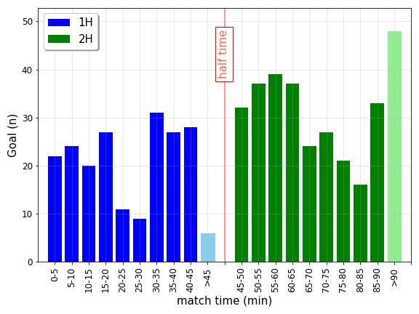
Event Distribution In Time
Club
International

Slide 12
Analysis Questions

Slide 13
Characterizing Teams
Can we derive quantifiable metrics to characterize a team’s “playing style”?
Are certain types of teams effective against a team with a complementary playing style?

Slide 14
Characterizing Players
Are certain players more/less responsive to opposing players’ temperament or physiological traits?
Can player “versatility” be used for tactical advantage?
How big of a role do certain players play in influential matches?

Slide 15
League analysis
Is there an observable discrepancy between team playing styles across different leagues?
Can similar teams have radically different end-of-season outcomes depending on their domestic league?

Slide 16
Club vs International games
Is there a difference in the effectiveness of certain strategies between the club and international stage?
Under what conditions does (player) club form translate to international tournaments?

Slide 17
References
Pappalardo, L., Cintia, P., Rossi, A. et al. A public data set of spatio-temporal match events in soccer competitions. Sci Data 6, 236 (2019) doi:10.1038/s41597-019-0247-7, https://www.nature.com/articles/s41597-019-0247-7
Pappalardo, Luca; Massucco, Emanuele (2019): Soccer match event dataset. figshare. Collection. https://doi.org/10.6084/m9.figshare.c.4415000

